Slide 1
Introduction to Programming I (CSE8A)

Slide 2
I like to be called "Joe" (or "Professor Politz" if you prefer using a title)
I like to study & build programming languages
I like dogs
I really like programming
I really like teaching programming

Slide 3
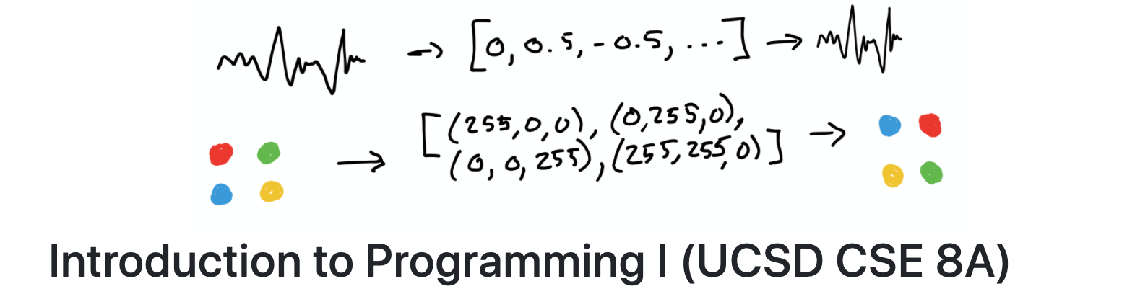
The Course Website – It's Useful!
Go to: https://ucsd-cse8a-w20.github.io/wi20/cse8a
Go to: http://cseweb.ucsd.edu/classes/fa18/cse8a
Or search for "UCSD CSE Class Homepages"
Or search for "Joe Politz UCSD"

Slide 4
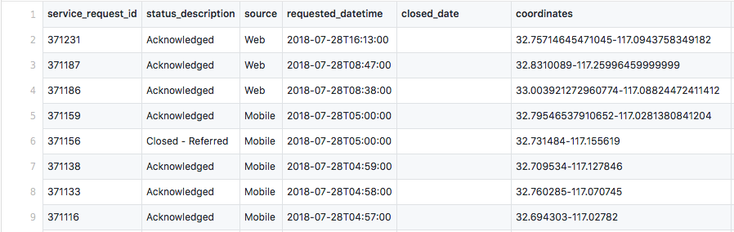
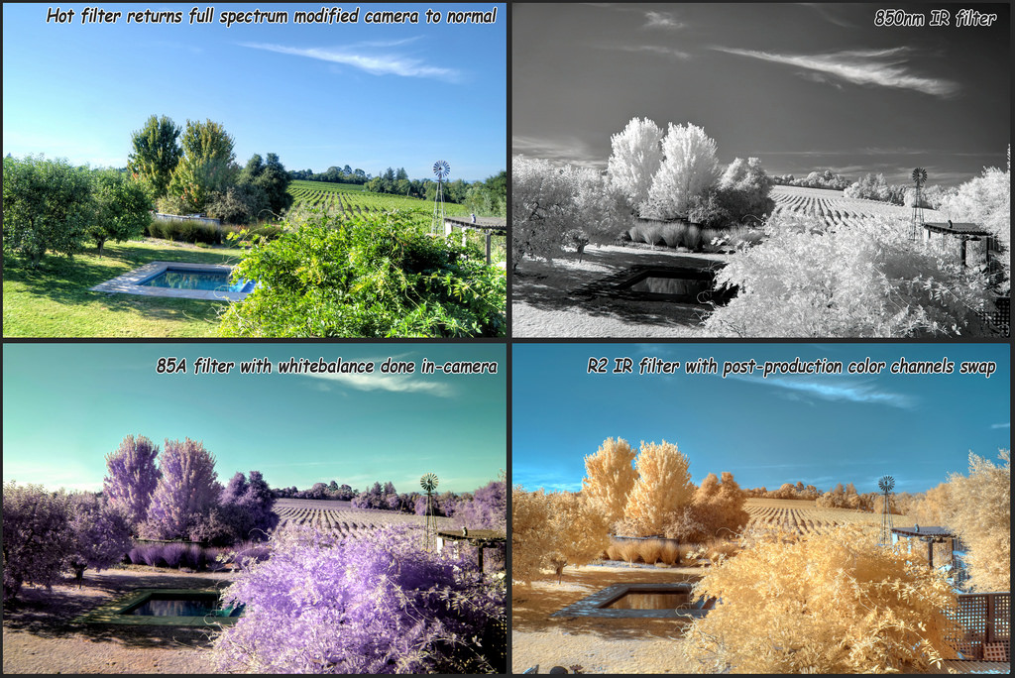
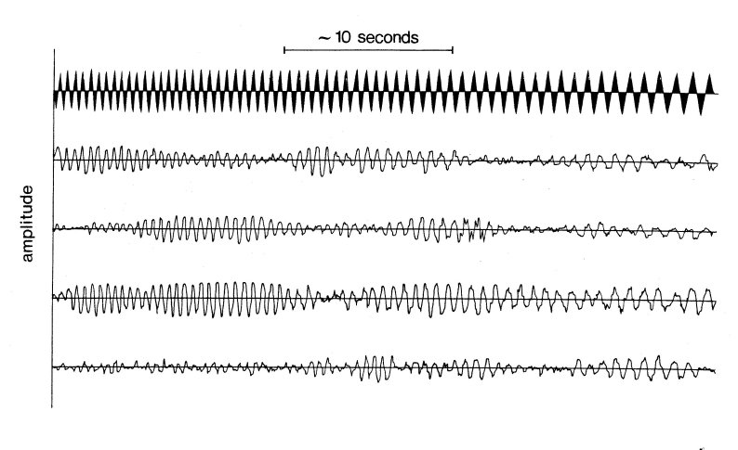
Work with interesting data

Slide 5
Staff Introductions

Slide 6
Reading & programming practice

Slide 7
Devices in class

Slide 8
Programming assignments

Slide 9
Assigned lab sections

Slide 10
Open lab hours

Slide 11
On-line Q&A on Canvas

Slide 12
ieng6 account setup

Slide 13

https://tinyurl.com/vdfkf9f

